Slide 1
Boosting Algorithm
By
Paul Clinton

Slide 2
AdaBoost Regressor
(Adaptive Boosting Algorithm)

Slide 3
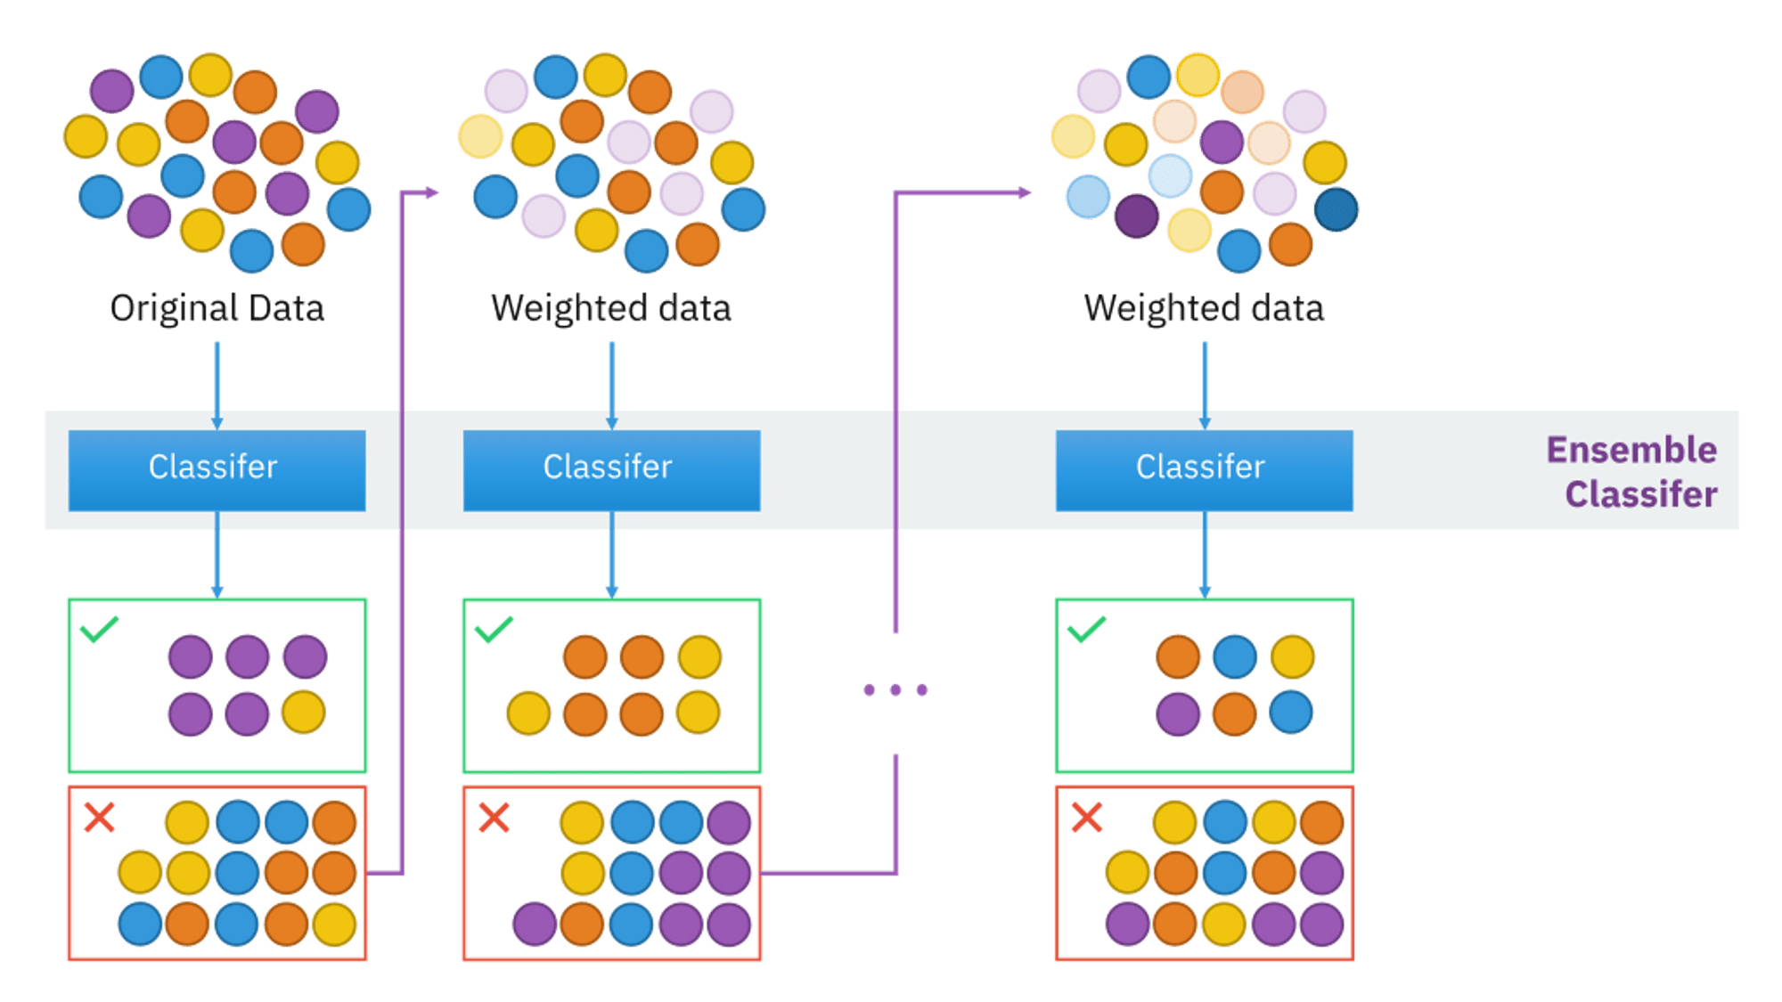
Adaboost Regressor
AdaBoost, is a machine learning algorithm that belongs to a family of methods known as ensemble methods.it is a boosting algorithm that combines multiple weak learners to create a strong learner for regression tasks. It builds a model iteratively by focusing on the data points that previous models mispredicted.

Slide 4
Working Principle
Starts with an initial model (weak learner), usually a decision tree.
Assigns equal weights to all training data points.
Iteratively trains a new model, focusing more on the points with high errors from the previous model.
Final prediction is a weighted average of all models.
Advantages
Improved accuracy by focusing on difficult cases, AdaBoost often provides better predictions than individual weak learners.
It can work with various types of weak learners and handle both classification and regression tasks.
Can achieve high accuracy.
Robust to overfitting in certain scenarios.
Effective with less tuning compared to other models.
Disadvantages
Sensitive to noisy data and outliers.
Requires careful selection of weak learners.
Performance heavily depends on the quality of the base model.
Applications:
Used in financial forecasting, risk management, and prediction models.
Suitable for any regression problem where boosting is beneficial.

Slide 5
XGBoost Regressor
(Extreme Gradient Boosting Algorithm)

Slide 6
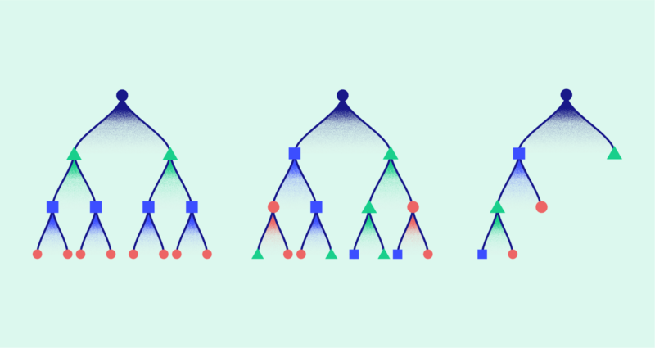
XGBoost Regressor
XGBoost is a powerful and widely-used ensemble learning technique that extends gradient boosting for better performance and efficiency. It has gained popularity in machine learning competitions and real-world applications due to its speed and accuracy.

Slide 7
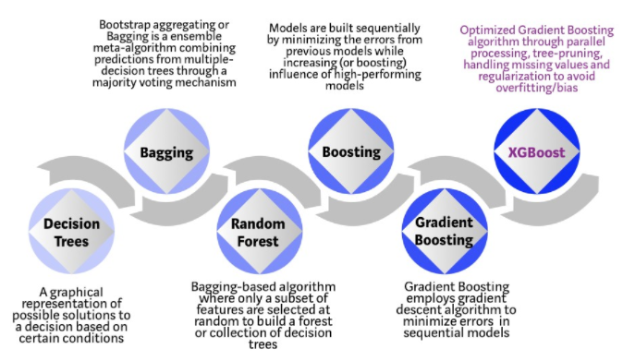

Slide 8
Working Principle
1. Gradient Boosting Framework:
Boosting: where weak learners (typically decision trees) are sequentially added to the model. Each new learner focuses on correcting the errors made by the previous ones. This process continues until the model reaches a specified number of iterations or the errors are minimized.
Gradient Descent: the boosting process is guided by gradient descent. Each iteration aims to minimize the loss function by computing gradients with respect to the model's predictions.
2. Regularization:
L1 and L2 Regularization: XGBoost incorporates both L1 (Lasso) and L2 (Ridge) regularization terms in its objective function. These terms penalize large coefficients in the model, reducing the likelihood of overfitting by controlling the complexity of the trees.
Objective Function: The regularized objective function in XGBoost balances the trade-off between model complexity and training loss. This helps in achieving better generalization on unseen data.
3. Tree Pruning and Sparsity Awareness:
Tree Pruning: XGBoost uses a process called "tree pruning" to remove branches

Slide 9
Advantages
High Performance and Accuracy
Regularization to Prevent Overfitting
Handling Missing Data
Flexibility:
Wide Range of Parameters: It offers a variety of hyperparameters, allowing customization for different tasks. It can be tailored for classification, regression, and ranking problems.
Custom Objective Functions: You can define custom loss functions, making it adaptable to various machine learning problems.
Support for Cross-Validation and Early Stopping:
It has built-in support for cross-validation and early stopping, which can help in tuning the model and preventing overfitting during training.
Feature Importance:
It provides a clear view of feature importance, allowing you to understand which features contribute the most to predictions, which is useful for model interpretability.
Scalability:
It is highly scalable and can handle large datasets efficiently. It supports distributed computing, making it suitable for big data applications.

Slide 10
Disadvantages :
Complexity and Hyperparameter Tuning:
Many Hyperparameters:
Tuning Process can be time-consuming
Risk of Overfitting:
High Memory Usage
Not Easily Interpretable
Longer Training Time for Large Models
Sensitivity to Outliers.
Applications:
Data Science
Finance and Banking-Credit Scoring,Fraud Detection,Risk Management
Healthcare - Disease Prediction , Medical Diagnosis, Healthcare Resource Allocation
E-commerce and Retail
Marketing and Advertising
Telecommunications
Automotive and Manufacturing

Slide 11
LG Boost Regressor
(Light Gradient Boosting Algorithm)

Slide 12
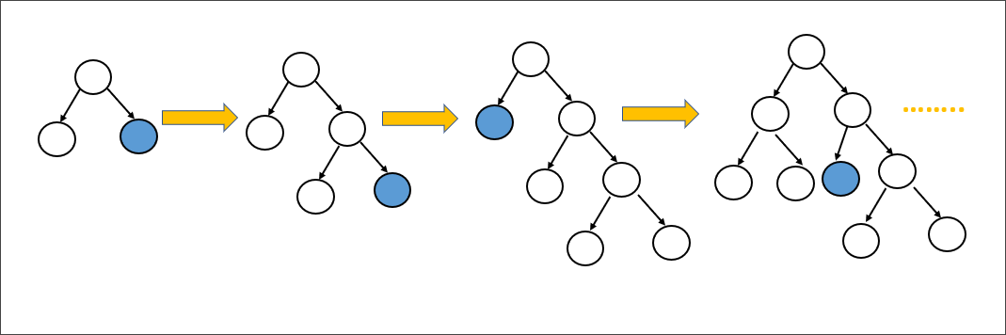
Light Gradient Boosting Algorithm
Light Gradient Boosting is a high-performance gradient boosting framework designed for efficient and scalable machine learning tasks. It is specially for speed and accuracy, used for both structured and unstructured data in diverse domains. its ability to handle large datasets with millions of rows and columns, support for parallel and distributed computing, and optimized it known for its excellent speed and low memory consumption.

Slide 13
Working Principle
Gradient Boosting: Builds trees iteratively, focusing on correcting the errors of the previous models.
Leaf-Wise Tree Growth: Expands the leaf with the highest loss reduction, allowing deeper trees and potentially more accurate models.
Histogram-Based Learning: Uses binned data for faster and more memory-efficient tree splitting.
GOSS: Focuses on the most important data points by selectively sampling based on gradients.
EFB: Reduces feature dimensionality by bundling mutually exclusive features.
Support for Categorical Features: Handles categorical data directly without preprocessing.
Distributed and GPU Learning: Scales efficiently for large datasets and supports parallel and GPU-based training.
Regularization and Early Stopping: Prevents overfitting by controlling model complexity and halting training when appropriate.

Slide 14
Advantages:
Speed: LightGBM is faster than traditional gradient boosting algorithms, particularly with large datasets.
Low Memory Usage: The histogram-based approach and efficient data handling lead to lower memory consumption.
High Accuracy: The leaf-wise tree growth can result in more accurate models, especially when tuned correctly.
Scalability: LightGBM is designed to scale well with large datasets and can be distributed across multiple machines.
Support for Categorical Features: LightGBM can handle categorical features directly without needing to one-hot encode them, reducing complexity.
Disadvantages:
Overfitting Risk: The leaf-wise growth can lead to overfitting if not carefully tuned, particularly with small datasets.
Complexity in Tuning: While LightGBM can provide high accuracy, it may require careful parameter tuning, especially for controlling overfitting.
Sensitivity to Hyperparameters: The performance of LightGBM can be highly dependent on hyperparameter settings, requiring extensive tuning.

Slide 15
Application:
Finance:
Credit Scoring: LightGBM is used for predicting the likelihood of loan defaults or credit risk, leveraging its ability to handle large and complex datasets.
Algorithmic Trading: In financial markets, LightGBM is used to model and predict price movements based on historical data.
E-commerce:
Recommendation Systems: LightGBM powers recommendation engines by predicting user preferences and behaviors.
Customer Segmentation: It helps in clustering customers based on their behavior, allowing for personalized marketing.
Healthcare:
Disease Prediction: Like XGBoost, LightGBM is used in predictive models for disease diagnosis, analyzing patient data for patterns.
Patient Outcome Prediction: It helps predict patient outcomes and treatment effectiveness.
Marketing and Advertising:
Ad Targeting: LightGBM models are used to predict which ads are most likely to engage users, improving ad placement strategies.
Churn Prediction: Companies use this to predict which customers are likely to leave, allowing them to take preventive measures.
Energy:
Consumption Forecasting: Energy companies use LightGBM to predict energy usage patterns and optimize grid management.
Fault Detection: In power systems, it can detect potential faults and prevent failures.
Sports Analytics:
Performance Analysis: It helps in analyzing player and team performance by processing large datasets with multiple features.

